Slide 2

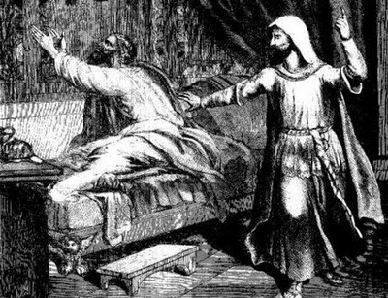
Isaiah 38:1-5
“Set your house in order, for you shall die and not live.”

Slide 3
Setting Your House In Order
We Shall ALL SURELY DIE and NOT LIVE!

Slide 4
What Needs Setting In Order In Our House?
What GOD wants us to have in our homes

Slide 5
AUTHORITY
Ephesians 5:22,23 “Wives, submit to your own husbands, as to the Lord…”
The HUSBAND is to be HEAD of the WIFE – WIFE to SUBMIT TO HUSBAND
Genesis 2:18 “helper comparable to him.”
Teach Children RESPECT FOR AUTHORITY – Proverbs 23:13,14
Ephesians 6:1-3 "...obey your parents in the Lord, for this is right..”
Ephesians 6:4 “do not provoke your children to wrath, but bring them up in the training and admonition of the Lord."
IS your house in order when it comes to AUTHORITY?

Slide 6
LOVE
Ephesians 5:25 “...love your wives, just as Christ also loved the church and gave Himself for it."
Titus 2:3,4 “…admonish the young women to love their husbands, to love their children”
1 Corinthians 13:5 "does not behave rudely, does not seek its own, is not provoked, thinks no evil."
1 Timothy 5:8 “provide for his own, and especially for those of his household”
True Love seen in MUTUAL RESPECT and CONCERN for each other
IS your house is order when it comes to LOVE?

Slide 7
GOOD COMPANIONSHIP-
1 Peter 3:7 “giving honor to the wife, as to the weaker vessel”
Proverbs 25:24 “better to dwell in a corner of a housetop, than in a house shared with a contentious woman."
Proverbs 27:15 “continual dripping on a very rainy day and a contentious woman are alike."
Proverbs 31:10-29 – the kind of woman God would have them be
Husbands & Wives doing the part God designed for them, their companionship will be GOOD in every aspect of life.
IS your house in order when it comes to GOOD COMPANIONSHIP?

Slide 8
GOOD LITERATURE-
Many magazines “not quite porno” but contains stories not fit to be read by Christians
T. V. shows using filthy language and portraying immoral lifestyles
Proverbs 23:7 “"for as he thinks in his heart, so {is} he."
More time needs to be spent reading the Bible – less with evil companions – 1 Corinthians 15:33
Encourage children by WORD and EXAMPLE to spend time studying their Bible Lessons
IS your house in order when it comes to GOOD LITERATURE?

Slide 9
GOOD PARENTAL EXAMPLES-
profanity, gambling, dancing, fornications, immodest dress, temper tantrums, wagging tongues that spread gossip, covetousness, etc.
Will SEE these things, and GROW UP JUST LIKE YOU!
IS that what you WANT?
NO one lives without influencing SOMEONE!
Romans 14:13 “rather resolve this, not to put a stumbling block or a cause to fall in {our} brother's way."
2 Timothy 1:5 “in your grandmother Lois & your mother Eunice”
IS your house in order when it comes to GOOD EXAMPLES?

Slide 10
Getting our houses in order – for we shall surely die!
IS YOUR HOUSE IN ORDER?

